Slide 1

NORMAL DISTRIBUTION
SANTOSH CHHATKULI

Slide 2
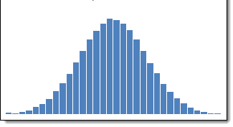
Introduction
A normal distribution is a most important continuous probability distribution that is symmetric around its mean.
It follows a bell-shaped curve, where most values cluster around the central peak, and probabilities decrease as you move further from the mean.
The distribution is frequently called the Gaussian distribution in recognition of contribution made by Carl Friedrich Gauss.

Slide 3
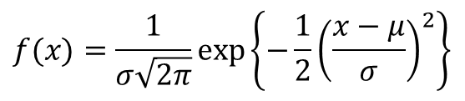
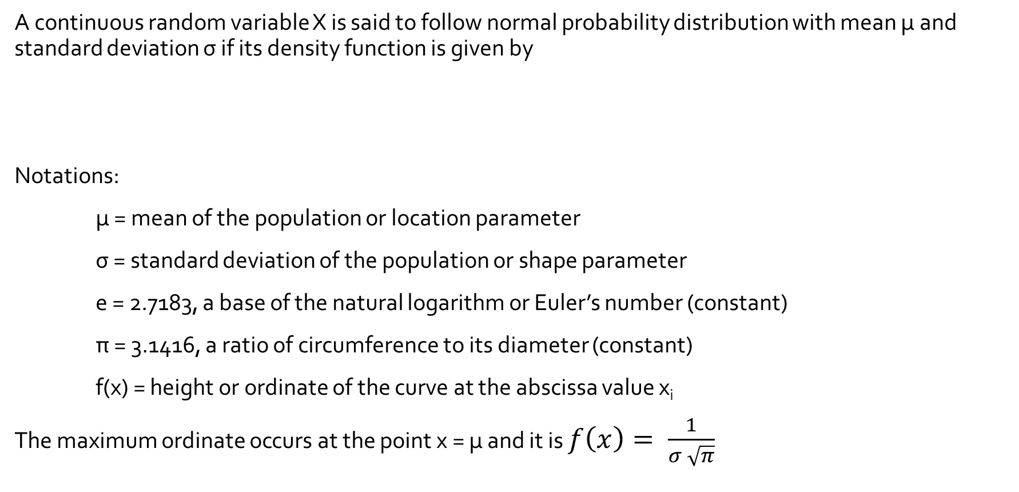
Probability Density Function of Normal Distribution
A continuous random variable X is said to follow normal probability distribution with mean µ and standard deviation σ if its density function is given by
Notations:
µ = mean of the population or location parameter
σ = standard deviation of the population or shape parameter
e = 2.7183, a base of the natural logarithm or Euler’s number (constant)
π = 3.1416, a ratio of circumference to its diameter (constant)
f(x) = height or ordinate of the curve at the abscissa value x_{i}
The maximum ordinate occurs at the point x = µ and it is $f\left(x\right)= \frac{1}{σ \sqrt{π}}$
$$f(x)=\frac{1}{σ\sqrt{2π}}\exp\left\{−\frac{1}{2}{\left(\frac{x−μ}{σ}\right)}^{2}\right\}$$

Slide 4
Characteristics of Normal Distribution
The normal distribution possesses following important characteristics:
The probability curve is bell shaped
The normal curve is symmetric around the mean. It implies that mean of a normally distributed population lies at the center of its curve i.e. at x = µ. The further a value is from the mean, the less likely it is to occur.
Normal distribution is unimodal distribution (single mode distribution). This peak represents the most likely value (mode) in the distribution.
All measures of central tendency are all equal i.e. mean = median = mode.
The tails of the normal distribution extend infinitely in both directions without touching the x-axis (Asymptotic Nature)
The total area under the normal curve above the X-axis is one square unit. The area under the normal curve represents probability
The shape of the normal curve is defined by two parameters µ and σ. Changing μ shifts the curve left or right. Changing σ affects the spread. Larger σ means wider, flatter curve. Smaller σ narrower, taller curve.

Slide 5
Importance of Normal Distribution
The distribution of many continuous variables such as height, weight, blood pressure etc. is approximately normal.
The measurement whose distribution is not normal, a simple transformation of the scale of measurements may induce normality. Hence the normal distribution can be used to solve the probability problem even in the skewed distribution.
An essential requirement for employing many statistical test such as t-test, ANOVA and tools such as regression, correlation and any other parametric analysis is that observations must have distribution not significantly different from normality. Thus, Normal Distribution serves as the foundation for classical statistical inference.
The normal distribution is relatively easier to work with mathematically.
We can use normal distribution to approximate various discrete probability distributions such as Poisson distribution, Binomial distribution and thereby avoid much computational drudgery.
We can standardize the values (raw scores) of a normal distribution by converting them into z-scores.

Slide 6
Parameters of Normal Distribution
To define particular normal distribution, we need only two parameters-the population mean (µ) and population standard deviation (σ). In other words, a different normal distribution is specified for each different value of µ and σ.
The two normal distributions having same mean but different standard deviations have different shape of normal curve. The curve with large σ is lower at the mean and spreads wider and value of X that are far from the mean are more frequent.
Parameter µ is called location parameter and σ is called size parameter. The parameter σ determines the peakedness and flatness of the normal curve.

Slide 7
Area property of Normal Distribution
The empirical rule in statistics allows researchers to determine the proportion of values that fall within certain distances from the mean.
If the data values in a normal distribution are converted to Z-scores in a standard normal distribution the empirical rule describes the percentage of the data that fall within specific numbers of standard deviations (σ) from the mean (μ) for bell-shaped curves.
For any normally distributed population
68.26 % or roughly two-third of all the observations lie in the interval µ ± σ. Out of remaining 31.74 % or roughly one-third of observations, half i.e. 15.58 % or roughly one-sixth will lie below the lower limit µ - σ and other half i.e. 15.58 % will be above the upper limit µ + σ.
95.44 % of all the observations lie in the interval µ ± 2σ, while 4.56 % of observations will be outside the limits i.e. values differ from the mean by more than twice the standard deviation is being only 4.56 %.
The limits µ ± 3σ include 99.74 % of all observations. Chance of values being higher than µ + 3σ and the lower than µ - 3σ is very rare and it is only 0.26 %.

Slide 8
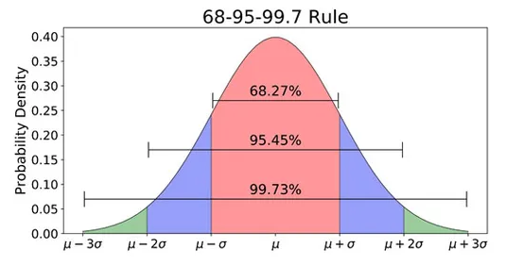

Slide 9
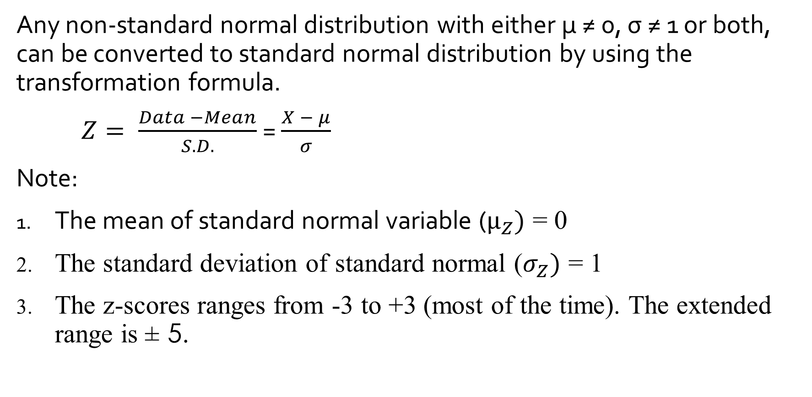
Standard Normal Distribution
Any non-standard normal distribution with either µ ≠ 0, σ ≠ 1 or both, can be converted to standard normal distribution by using the transformation formula.
$Z= \frac{Data −Mean}{S.D.}$ = $\frac{X − μ}{σ}$
Note:
The mean of standard normal variable ($µ_{Z})$ = 0
The standard deviation of standard normal ($σ_{Z})$ = 1
The z-scores ranges from -3 to +3 (most of the time). The extended range is ± 5.

Slide 10
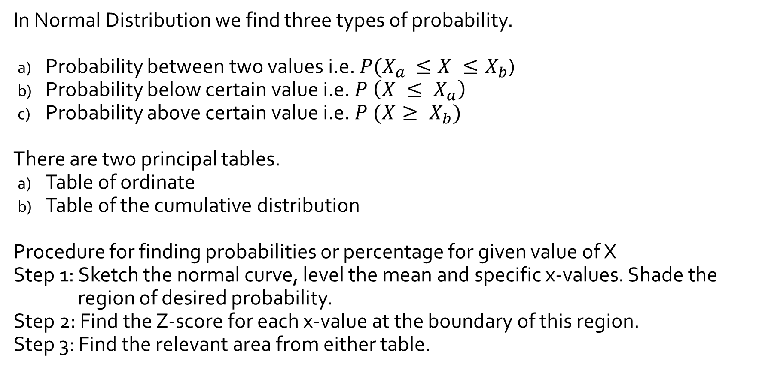
Table of Standard Normal Distribution
In Normal Distribution we find three types of probability.
Probability between two values i.e. $P(X_{a }≤X ≤X_{b}$)
Probability below certain value i.e. $P \left(X ≤ X_{a}\right)$
Probability above certain value i.e. $P (X≥ X_{b})$
There are two principal tables.
Table of ordinate
Table of the cumulative distribution
Procedure for finding probabilities or percentage for given value of X
Step 1: Sketch the normal curve, level the mean and specific x-values. Shade the region of desired probability.
Step 2: Find the Z-score for each x-value at the boundary of this region.
Step 3: Find the relevant area from either table.

Slide 11
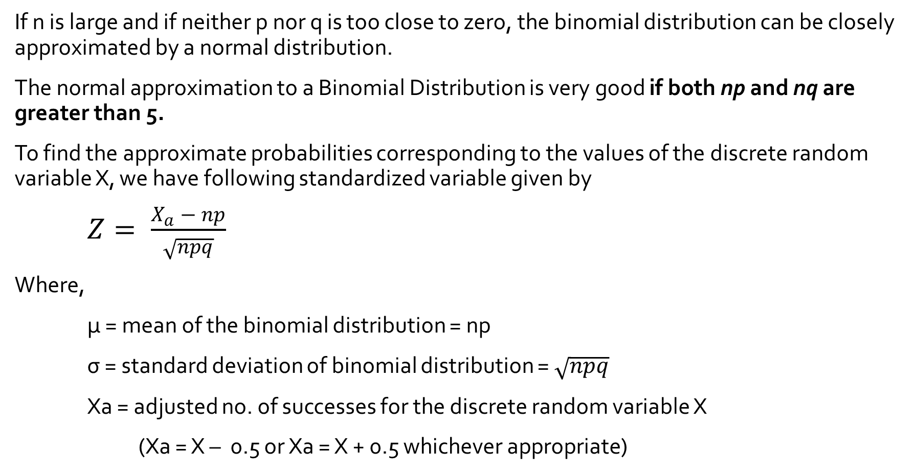
Normal Distribution as an approximation of Binomial Distribution
If n is large and if neither p nor q is too close to zero, the binomial distribution can be closely approximated by a normal distribution.
The normal approximation to a Binomial Distribution is very good if both np and nq are greater than 5.
To find the approximate probabilities corresponding to the values of the discrete random variable X, we have following standardized variable given by
$Z= \frac{X_{a} − np}{\sqrt{npq}}$
Where,
µ = mean of the binomial distribution = np
σ = standard deviation of binomial distribution = $\sqrt{npq}$
Xa = adjusted no. of successes for the discrete random variable X
(Xa = X – 0.5 or Xa = X + 0.5 whichever appropriate)

Slide 12
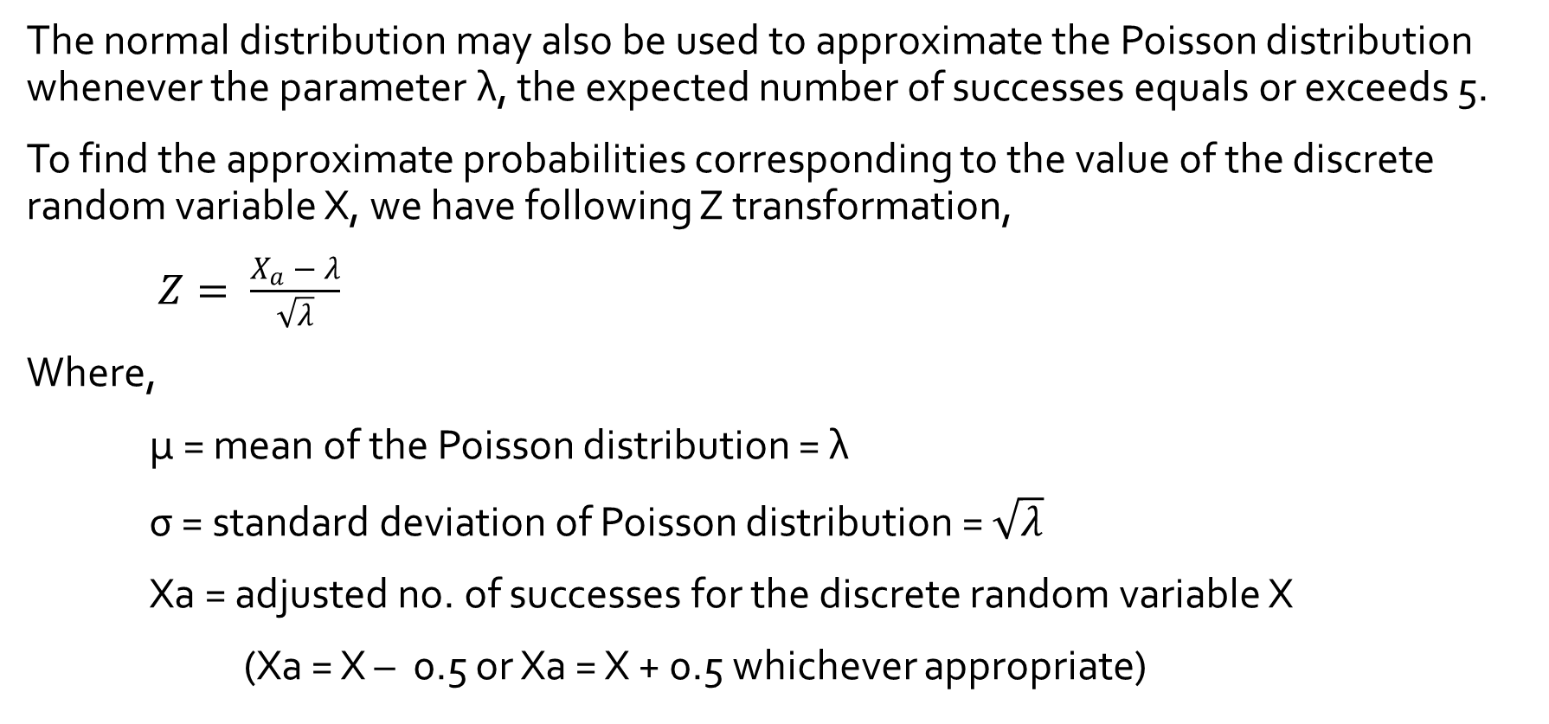
Normal Distribution as an approximation of Poisson Distribution
The normal distribution may also be used to approximate the Poisson distribution whenever the parameter λ, the expected number of successes equals or exceeds 5.
To find the approximate probabilities corresponding to the value of the discrete random variable X, we have following Z transformation,
$Z= \frac{X_{a} − λ}{\sqrt{λ}}$
Where,
µ = mean of the Poisson distribution = λ
σ = standard deviation of Poisson distribution = $\sqrt{λ}$
Xa = adjusted no. of successes for the discrete random variable X
(Xa = X – 0.5 or Xa = X + 0.5 whichever appropriate)

